Slide 1
Acute Leukemia: Blast morphology
Hypogranular APL:
bilobed or folded nuclei
Blasts cannot be reliably distinguished from each other based on morphology alone.
The exception are blasts with Auer Rod(s) which are unique to abnormal Myeloblasts and abnormal promyelocytes as noted in some AMLs and APL.
HematologyOutlines.com

Slide 2
Case
29M p/w 2 weeks of fatigue and syncope with leaning forward
HR 120s, BP 110s/70s, on RA.
CMP/CBC/PT/PTT wnl.
Sitting up at 90º, dyspneic with laying flat or leaning forward
CTA chest shows a 20cm mediastinal mass with SVC compression, moderate pericardial effusion, and mass effect on the heart, aorta, trachea, carina, right PA, and right PVs
Transferred from Fargo, ND to HCMC ICU for thoracic surgery evaluation
ICU calls you and asks “Should we start steroids?”
What other clinical info do you want to know?
Which oncologic emergencies are you thinking about?
Notes:
Pemberton’s, pulsus paradoxus, ECG, TTE, AFP, HCG, LDH, uric acid
What do cardiology and IR think?
Diagnosis before treatment (ideally)

Slide 3
Case
Exam: AOx3, no stridor. Pulsus paradoxus, Pemberton’s sign not assessed
Labs: LDH, uric acid, AFP, bHCG pending
ECG: electrical alternans
TTE:
EF 55%
moderate to large pericardial effusion
Mildly swinging heart and respirophasic tricuspid inflow variation that is consistent with pre-tamponade physiology.
No definite mitral inflow variation or echocardiographic pulsus alternans
Likely extrinsic compression of the left atrium with distorted anatomy

Slide 4
Anterior mediastinal mass dDx
4 T’s
Teratoma/Testicular
Terrible lymphoma
Thymoma
Thymic carcinoma
Anytime lymphoma is on the dDx, treatment with steroids should be avoided as long as safely possible until a diagnosis is confirmed
An inadequate diagnosis can preclude curative treatment
JTO 2014 Sep;9(9 Suppl 2):S102-9.
Notes:
FIGURE 1. Anterior mediastinal tumors in patients over age 40 years. Proportion of tumor types by decades of age: (A) Women, (B) Men. Modified from Detterbeck F. Clinical Approach to Mediastinal Masses.¹ HD/MLC-NHL, Hodgkin's disease/mediastinal large cell non-Hodgkin's lymphoma; LB-NHL, lymphoblastic non-Hodgkin's lymphoma; NSGCT, non-seminomatous germ cell tumor.
FIGURE 2. Anterior mediastinal tumors in patients age 10 to 39 years. Proportion of tumor types by decades of age: (A) Women, (B) Men. Modified from Detterbeck.¹ HD/MLC-NHL, Hodgkin's disease/mediastinal large cell non-Hodgkin's lymphoma; LB-NHL, lymphoblastic non-Hodgkin's lymphoma; NSGCT, non-seminomatous germ cell tumor.

Slide 5
Cardiac tamponade, SVC syndrome, Malignant airway obstruction
Short answer: mechanical interventions are faster than chemotherapy or radiation
Tamponade – pericardiocentesis vs drain placement vs pericardiotomy
SVC syndrome – IR SVC stenting
Airway obstruction – surgical airway

Slide 6
SVC syndrome: treatment
Steroids may obscure a lymphoma diagnosis
Palliative radiation may preclude definitive radiation later
Radiation usually requires laying flat
Springerplus. 2016; 5: 229.

Slide 7
Pemberton’s sign (thoracic outlet obstruction)
@paulgamboad, @grepmeded

Slide 8
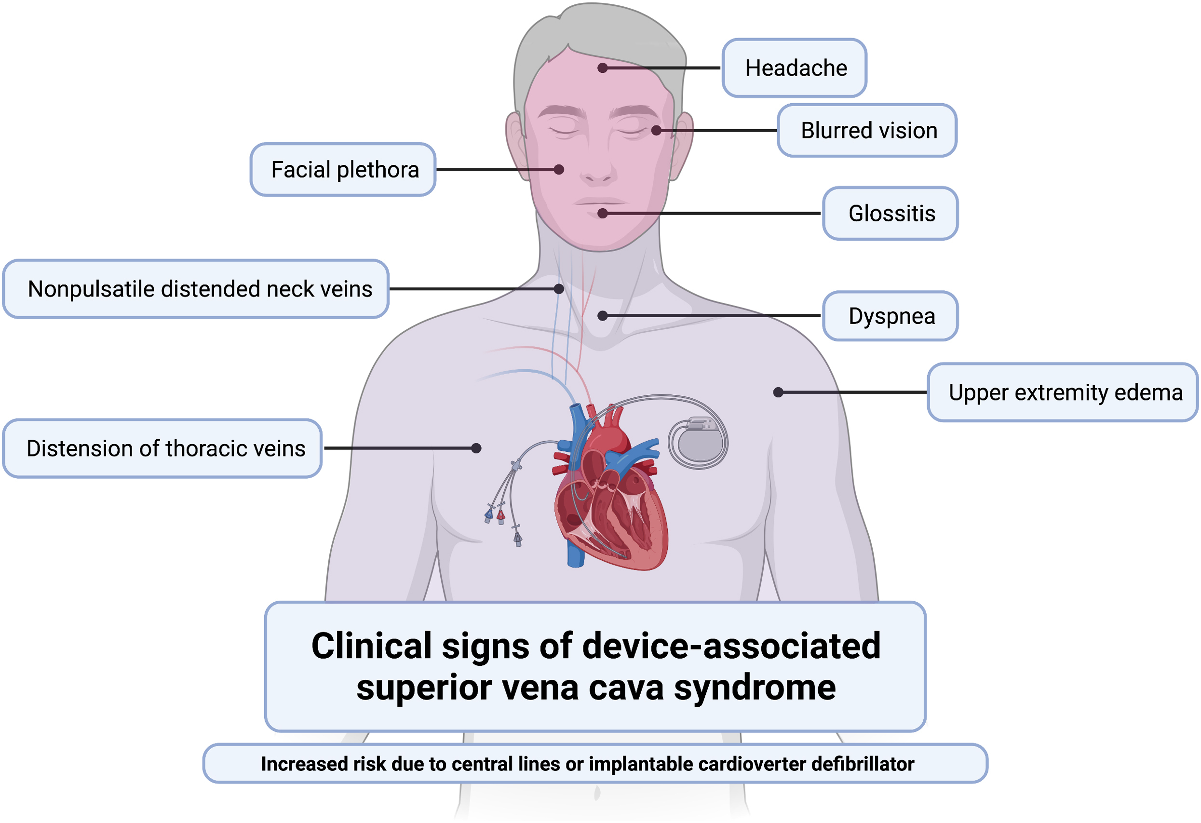
SVC syndrome
Feared complications:
Cerebral edema
Laryngeal edema
NEJM 2007; 356:1862-1869,
JACC 2021 Nov, 3 (15) 1690–1693
Notes:
Figure 1. The Superior Vena Cava Syndrome.Clinical findings in a patient with the superior vena cava syndrome, including facial edema, plethora, jugular venous distention, and prominent superficial vascularity of neck and upper chest, are shown in Panel A. The vascular anatomy of the upper chest, including the heart, superior vena cava, inferior vena cava, and subclavian vessels, is shown in Panel B. The tumor is shown compressing the superior vena cava.

Slide 9
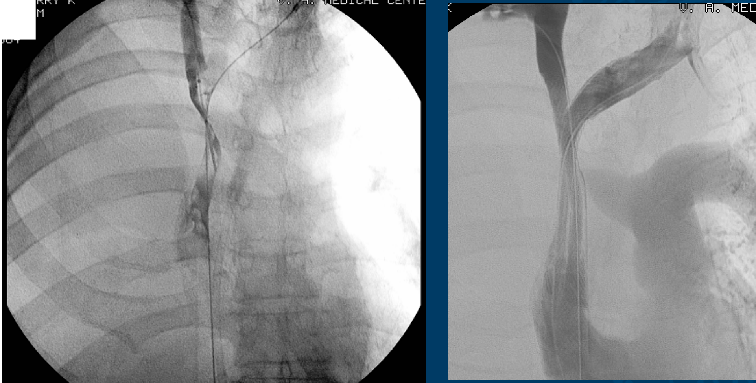
SVC stenting

Slide 10
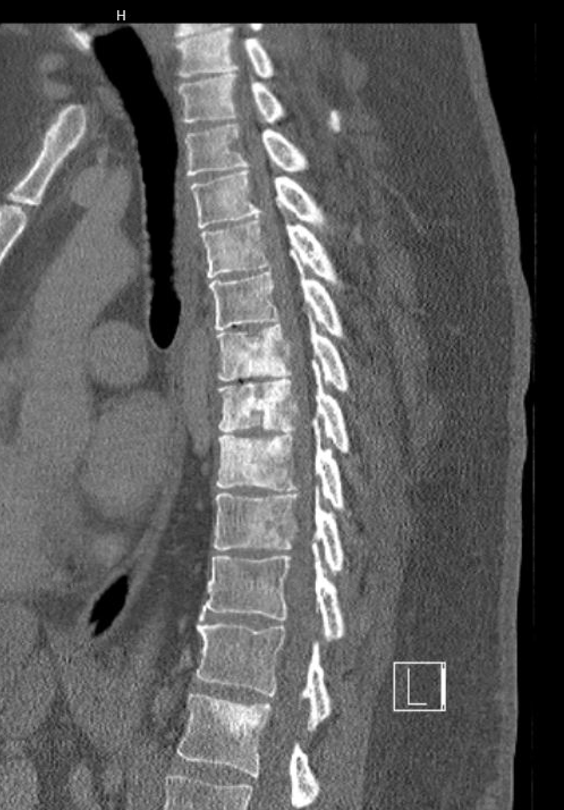
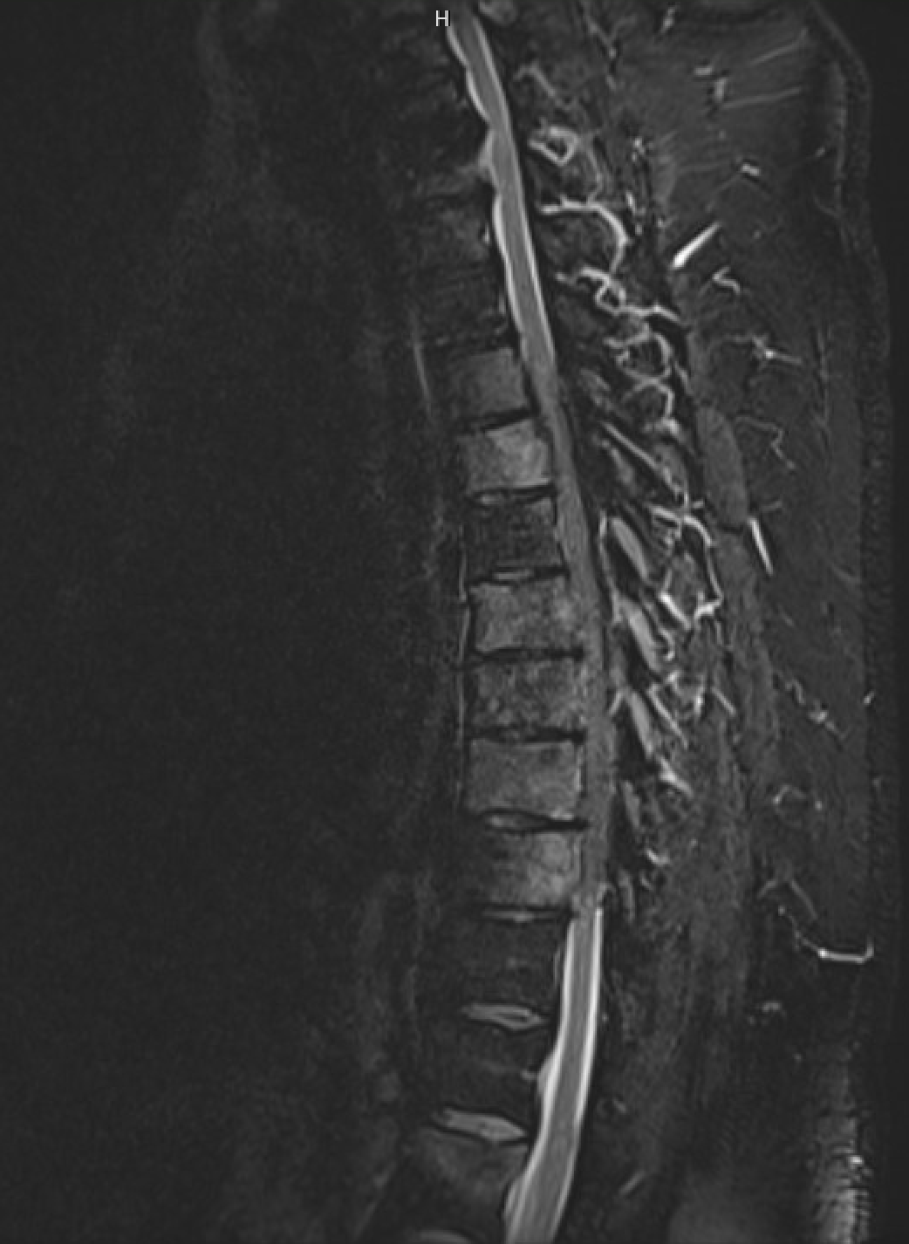
Case:
55M correctional officer p/w acute onset of lower extremity numbness and weakness upon getting up from bed 9 days prior to presentation to Regions
PSA 150
What do you recommend?

Slide 11
Cord compression
Pathophysiology
Metastases to the spinal column grow to gradually compress the spinal cord OR cause a vertebral fracture with sudden pain and neurologic deficits
15% cervical, 60% thoracic, 25% lumbar
Etiology:
Most common – breast, lung, prostate
Myeloma, NHL, RCC have a proclivity for spine; any cancer can cause it
History
Back pain (85%) with point tenderness, worse at night or with valsalva, radicular symptoms precede neurologic decline by weeks
Progresses over days to hours to motor weakness, inability to walk (70%) hyperreflexia, bowel/bladder incontinence, sensory level
Exam
Back/spine exam, percussion for point tenderness
Straight leg raise assessing for sciatica
Thorough neuro exam including strength, reflexes, Babinski, sensory exam, rectal tone, saddle anesthesia, post void residual
NEJM 2017; 376:1358-1369

Slide 12
Cord compression
Diagnosis
MRI full spine is the most sensitive and specific test
CT is generally not adequate unless MRI cannot be obtained; myelography is uncommon but more sensitive
Management: consult neurosurgery and radiation oncology
Surgery + radiation preserves ability to walk (84% vs 57%) and walking time (122d vs 13d) more than radiation alone
Spinal column stability and functional status are important factors in decision for surgery
Dexamethasone 10mg IV x1, then 4mg PO q6h
Tumor markers
Lancet. 2005 Aug 20-26;366(9486):643-8.

Slide 13
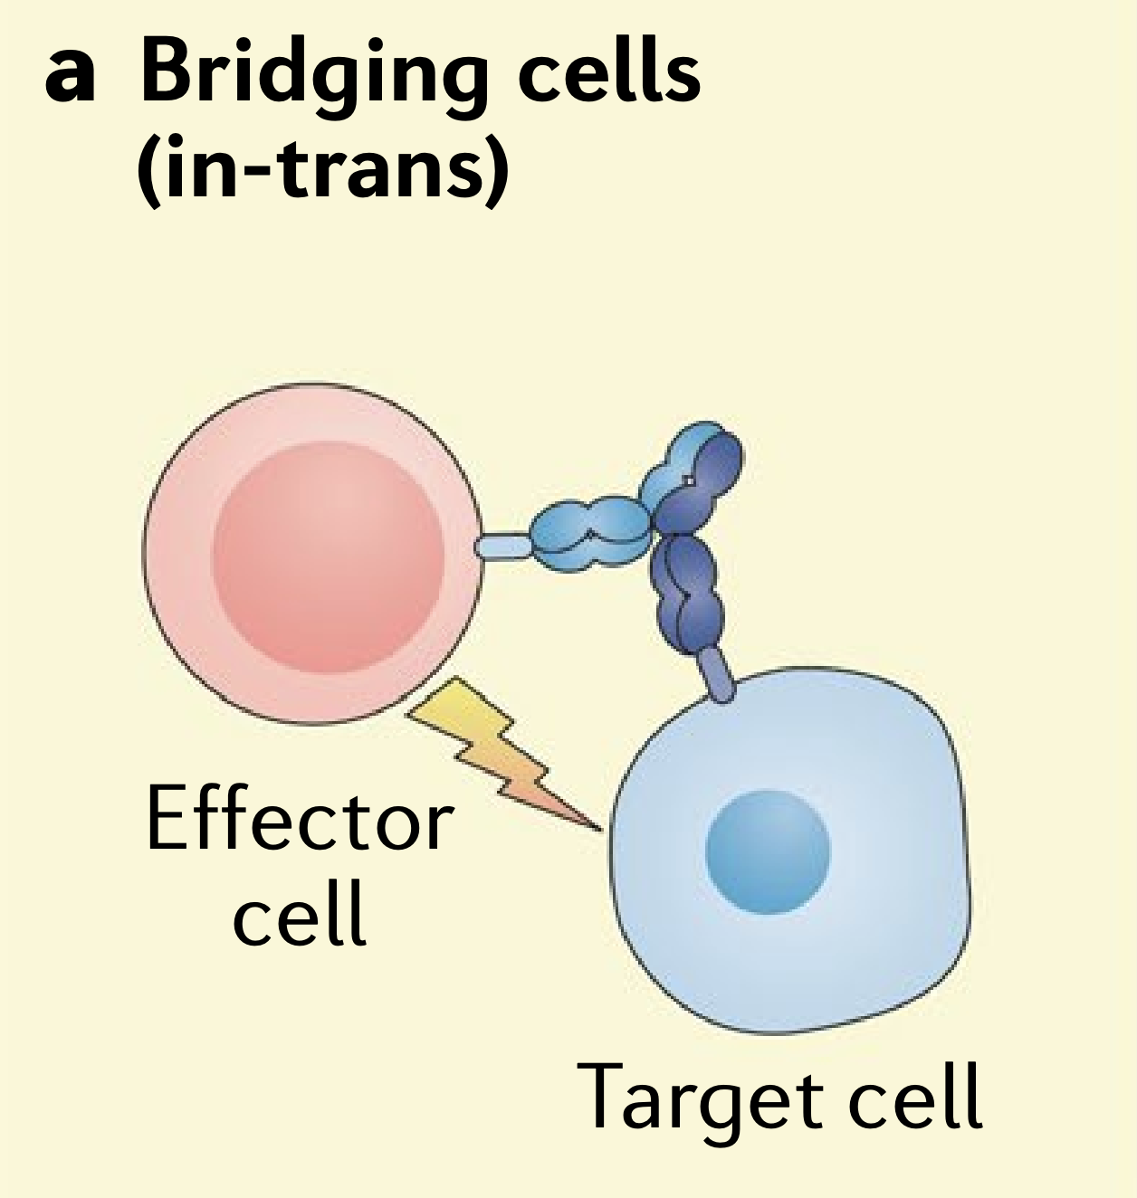
CRS/ICANS
Initially described with CAR-T
Can occur with any T-cell activating therapy e.g. blinatumomab (bispecific T-cell engager)
CRS 4 cardinal symptoms:
Fever
Hypoxia
Hypotension
Organ dysfunction
Treat grade 2-4 CRS with tocilizumab 8mg/kg IV
Treat grade 2-4 ICANS without CRS with Dexamethasone 10mg IV q6h
Nat Rev Immunol. 2022 Feb;22(2):85-96, Nat Rev Drug Discov 18, 585–608 (2019).

Slide 14
Cytokine release syndrome (CRS)
Nat Rev Immunol. 2022 Feb;22(2):85-96, J Immunother Cancer. 2018 Jun 15;6(1):56.
Notes:
Upon target recognition, chimeric antigen receptor (CAR) T cells are activated to produce cytokines, such as interferon-γ (IFNγ), granulocyte–macrophage colony-stimulating factor (GM-CSF) and tumour necrosis factor (TNF), and soluble inflammatory mediators (for example, catecholamines) that can activate macrophages and surrounding tissues. In addition, damage-associated molecular patterns (DAMPs) released by pyroptotic tumour cells are recognized by pattern-recognition receptors (PRRs) on macrophages and can further amplify their activation. In a contact-dependent manner, macrophage-expressed CD40 can be engaged by CAR T cell-expressed CD40 ligand (CD40L) and promote macrophage activation. Activated macrophages secrete inflammatory mediators, among which IL-6, IL-1 and nitric oxide (NO) produced by inducible nitric oxide synthase (iNOS) have been shown to be directly involved in the pathology of cytokine release syndrome (CRS). These cytokines may drive the systemic pathology of CRS owing to their ability to signal to a range of non-immune tissues such as the endothelium, which can result in vascular leakage, hypotension and further amplification of the inflammatory response by the secretion of cytokines and chemokines. It is hypothesized that locally produced chemokines attract circulating monocytes, which leads to an accumulation of activated macrophages at the site of interaction between CAR T cells and tumour cells, thus amplifying the inflammatory loop. Dashed lines denote hypothesized pathways that have not been experimentally confirmed in the context of CRS.
Clinical presentation of CRS. Beginning with fever and unspecific symptoms CRS might impact most organ systems. Mild cases can present as flu-like illness. Grade °III to IV shows signs of life threatening cardiovascular, pulmonary and renal involvement. Neurotoxicity can occur concurrent or with delay. Abbreviations: DIC: disseminated intravascular coagulation; INR: international normalized ratio; PTT: partial thromboplastin time

Slide 15
Immune effector cell-associated neurotoxicity syndrome (ICANS)
Nat Rev Immunol. 2022 Feb;22(2):85-96
Notes:
Similar to cytokine release syndrome (CRS), the pathophysiology of immune effector cell-associated neurotoxicity syndrome (ICANS) seems to start with the production of pro-inflammatory cytokines by chimeric antigen receptor (CAR) T cells and the activation of bystander immune cells such as macrophages in the tumour microenvironment. Inflammatory cytokines and chemokines produced by CAR T cells and myeloid cells in the tumour microenvironment — such as IL-1β, IL-6, IL-10, the chemokines CXCL8 and CCL2, interferon-γ, granulocyte–macrophage colony-stimulating factor and tumour necrosis factor — diffuse into the bloodstream and, eventually, result in disruption of the blood–brain barrier (BBB), with accumulation of cytokines and CAR T cells in the central nervous system (CNS) together with activation of resident microglial cells.

Slide 16
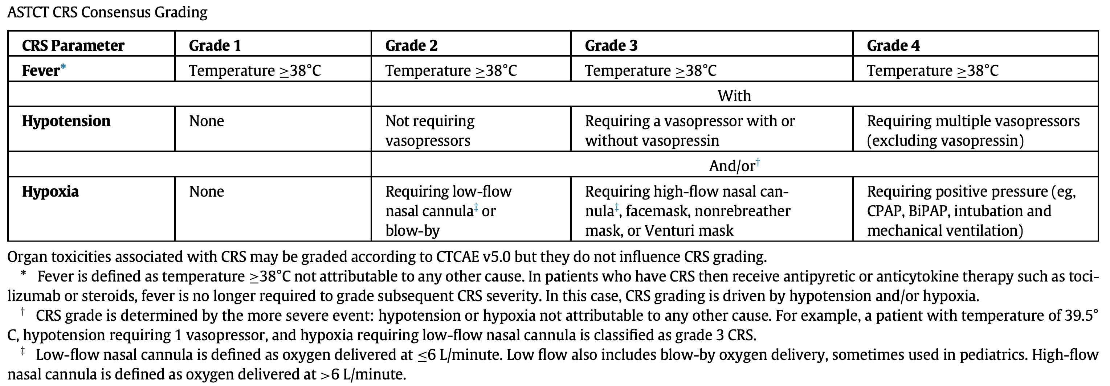
CRS: ASTCT grading
MDACC CARTOX app (apple, android), BBMT 2019 Apr;25(4):625-638.

Slide 17
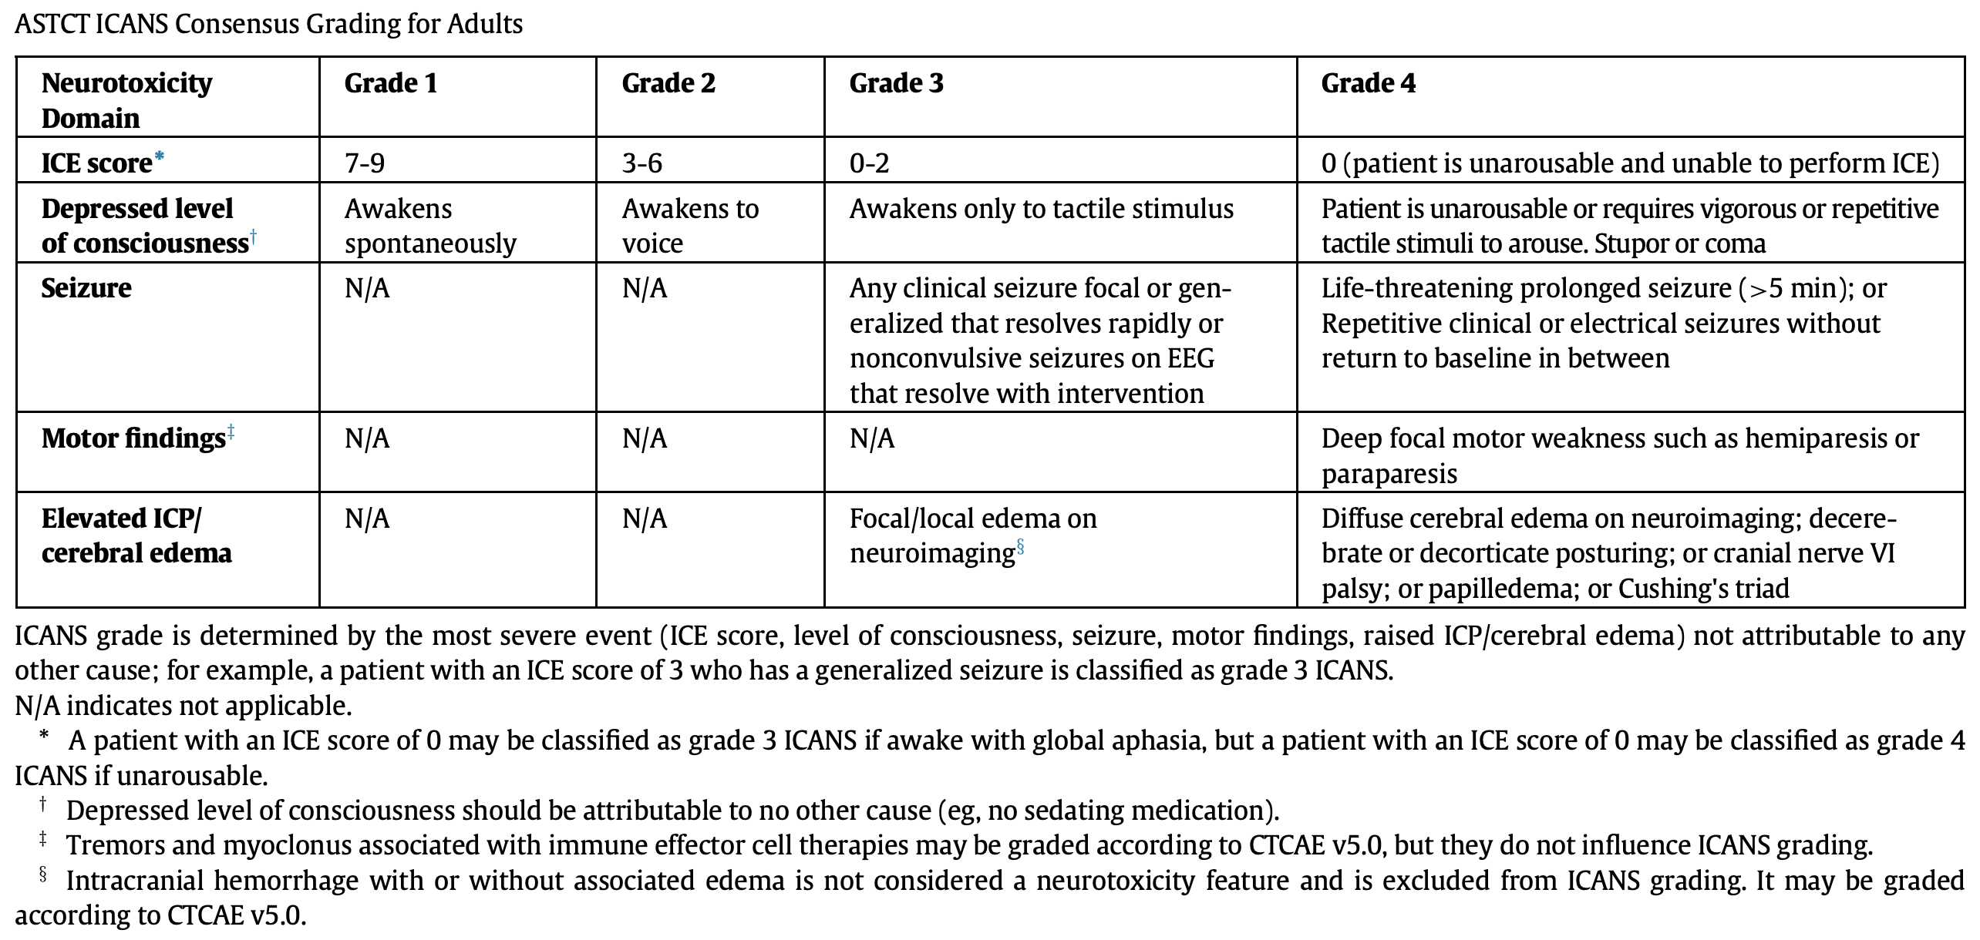
ICANS: ASTCT grading
MDACC CARTOX app (apple, android), BBMT 2019 Apr;25(4):625-638.

Slide 18
Anticoagulant reversal
Indications – life/limb threatening bleeding or emergent surgical procedure
Minor bleeding – hold anticoagulant, TXA/ACA (maybe avoid in hematuria)
Antiplatelets – PLT transfusion or DDAVP used but generally ineffective
Warfarin – Vitamin K, FFP, PCC
Heparins
UFH, LMWH – protamine sulfate (~60% effective for LMWH)
Fondaparinux – none; aPCC/FEIBA or rFVIIa; t½ 17-21h, washout 3-5 days; 77% renal excretion, ?dialyzable
Oral Xa inhibitors
Rivaroxaban, apixaban – andexanet alfa (ANNEXA-4), PCC; ~30% renal excretion
Edoxaban, betrixaban – off label andexanet alfa, PCC
Direct thrombin inhibitors
Dabigatran – idarucizumab (REVERSE-AD), aPCC/FEIBA if not available; 80% renal excretion, 50% dialyzable
Argatroban – none; t½ 45 mins; hepatic metabolism; 20% dialyzable
Bivalirudin – none; t½ 25 mins (up to 3.5h in renal failure); 25% dialyzable
AJH 2019;94:697–709, UpToDate, Blood (2019) 133 (5): 425–435.

Slide 19
Prothrombin complex concentrates
If a patient is bleeding despite activated factor products, look for another problem
None of these products contain fibrinogen, vWF, factors 8 or 13
Workup for DIC, consider cryoprecipitate and/or fibrinolytics
UpToDate

Slide 20
DOAC reversal MOA
“Decoy Factor Xa”
Marketing?
Circ 2016;134:248–261

Slide 21
Anticoagulant rever$al
WJEM. 2019 Sep; 20(5): 770–783.
Notes:
Generic PO Vitamin K price gouging – IV is cheaper than PO, can give IV formulation PO route; veterinary VitK $0.61 for a 50mg tablet; bag of leafy greens $5

Slide 22
Apheresis terminology
Plasmapheresis – removal of plasma (i.e. healthy donors)
Therapeutic plasma exchange – removal of plasma for a therapeutic purpose, replacement with either albumin/saline or FFP
Leukapheresis – removal of white blood cells
Exchange transfusion – removal of RBCs, replacement with transfused RBCs
Generally requires rigid central access (HD catheter), rarely two large PIVs are adequate
J Clin Apher. 2019;34:171–354.

Slide 23
Phase 1 trial patients – call the attending
Developmental Therapeutics Clinic at Fairview CSC
Examples of trials you probably won’t be able to google/uptodate
Oncolytic virus intratumoral injection
Solid tumor CAR-T/TILs
CAR-T switch therapy
Allo NK-cell and Allo CAR-T therapy
BiTEs
Most common issues are fevers +/- neutropenia, CRS, ICANS
Triage as you would for those conditions, call the attending on call
Trial protocols are on OnCore.umn.edu, but have to request access

Slide 24
Urgencies and emergencies
Classical Hematology
Hemophilia bleeding
TMA – TTP, aHUS, CAPS
HIT
Sickle cell crises
Anticoagulant reversal
Heme Malignancy
Acute leukemia and/or APL/DIC
TLS
Leukostasis/hyperviscosity
CRS/ICANS
Differentiation syndrome
General Oncology
Cardiac tamponade
SVC syndrome
Airway obstruction
Cord compression
Symptomatic brain metastases
Hypercalcemia
Neutropenic fever
Asplenic sepsis
Phase 1 trial patients
Immediately life/limb threatening without intervention?
Need peripheral smear overnight?

